Slide 1
Financial News Sentiment Analysis
ISM6562 – Team Project
Presented by: Tejas, Yesha, Dinh Tho

Slide 2
Process & Data Flow
Data Collection & Preparation
Descriptive
Analysis
Train
Model
Evaluate
Model
Application
Sentiment distribution
Train/Test Dataset
Confusion Matric
Save Pipeline & Model
Term distribution
Tokenize
Accuracy
Load Model
Hashing TF
ROC
Stream New Data
IDF (Inverse document frequency)
PRC
Predict sentiment of new data (news)
MLP (multi-layer perceptron)
Train Pipeline

Slide 3

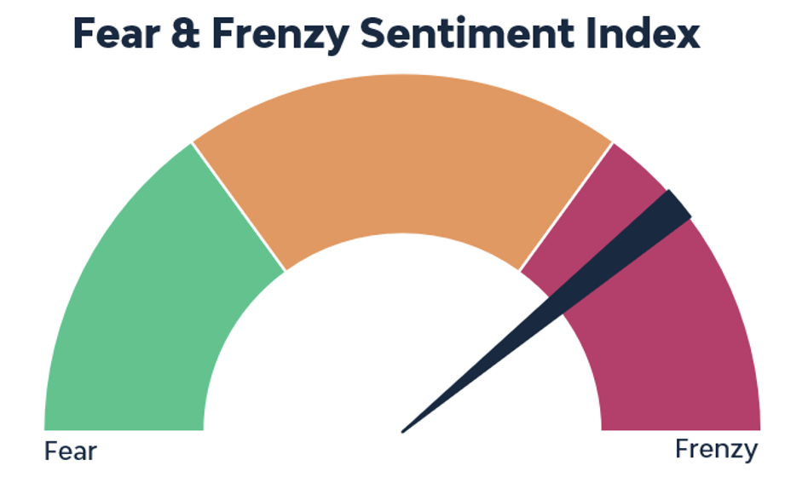
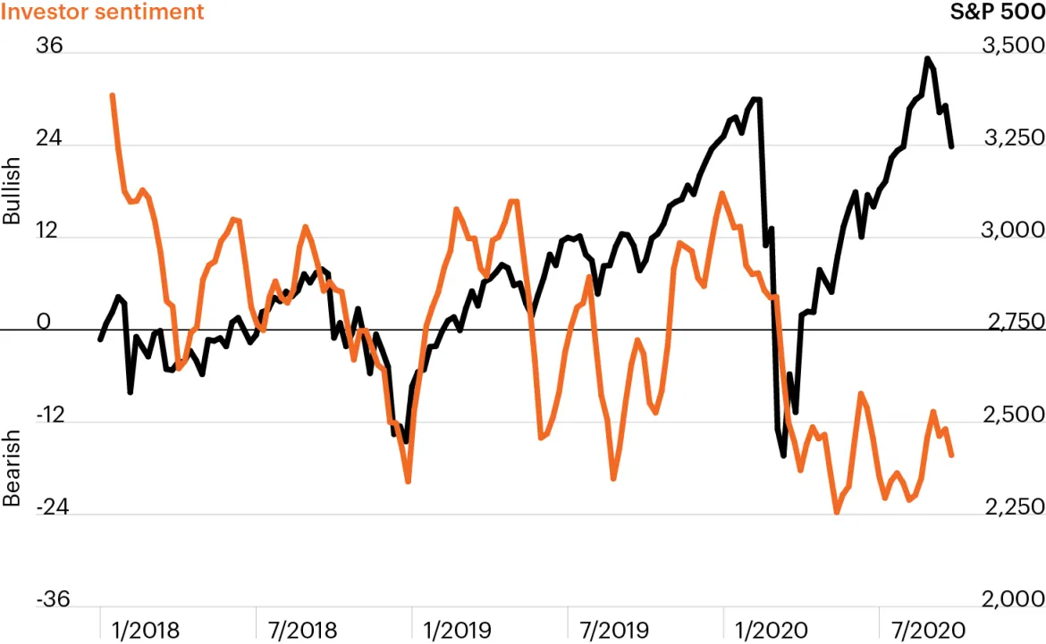
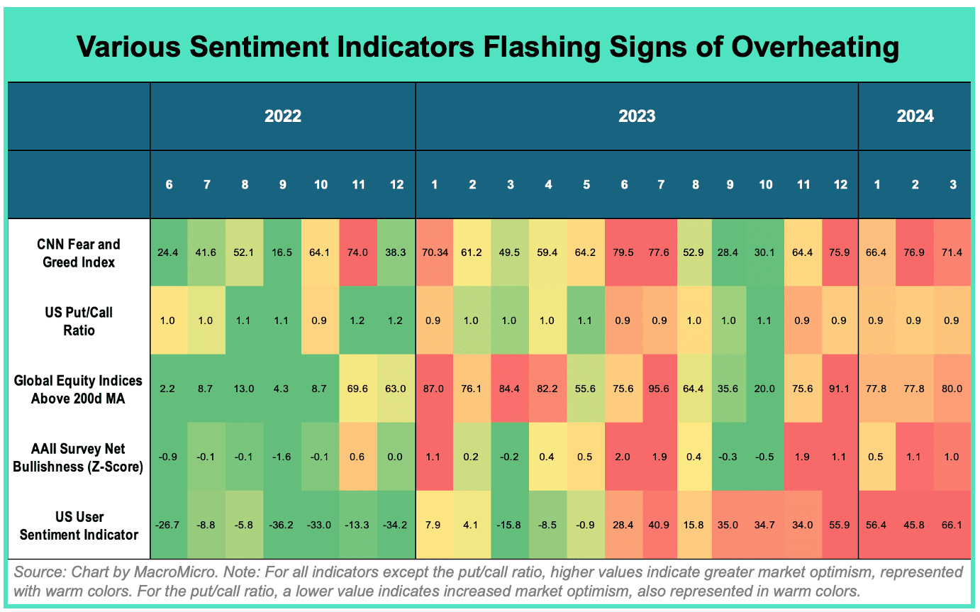
Prospective Application
Query sentiments
e.g. about Apple
Sentiment Index
NEWS / Social Media
TRAINED SENTIMENT ESTIMATOR
Daily news streaming
Sentiment trend
RE-TRAIN THE MODEL
Industry
Sentiment map

